Slide 1
Extracting Data from PDFs using Regular Expressions
Aakriti Jain
E-mail: aakritijain96@gmail.com
Github:https://github.com/Aakriti23
S&P Global Market Intelligence

Slide 2
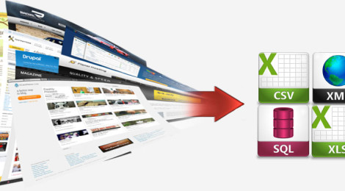
What is Data Extraction?
Data Extraction is a process of digging data from an unstructured/semi-structured data source in order to process it further and/or to store it.
It involves analysing data and retrieving relevant information from different data sources.
Extracting data doesn’t just provide valuable information for the business; it can also save an enormous amount of time, resources and money by automatically gathering the information required.

Slide 3
Challenges faced during Data Extraction
There is no one platform that can extract data from any source in any format in any language. With irregularities in data, any algorithm will need to be updated timely.
Change in the source formats can break our model and repairing the model results in downtime.

Slide 4
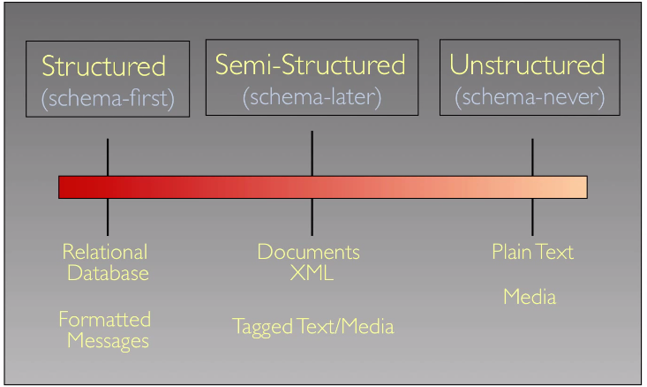
What is Structured/Semi-Structured/Unstructured Data?

Slide 5
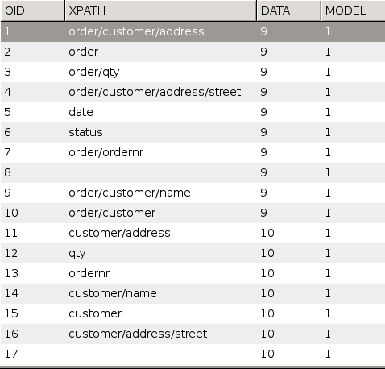
Structured Data
Structured Data - Data stored in tables with rows and columns is called Structured Data. This data contains well-defined data types and column headers that make it easier for machines as well as humans to read.
Common formats to store structured data - RDMS databases like SQL Database.

Slide 6
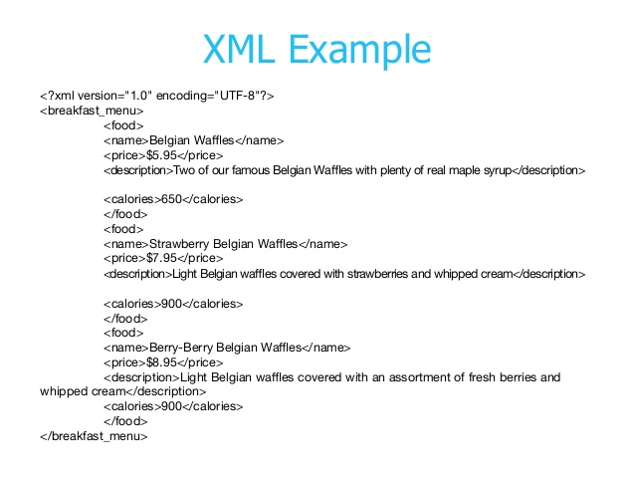
Semi-structured Data
Semi-Structured Data - Information doesn’t reside in a relational database but it does have some organizational properties that make it easier to analyze.
Common formats to store semi-structured data - XML, JSON, CSV etc.

Slide 7

Unstructured Data
This might/might not have internal structure but is not structured via pre-defined data models or schema. It may be textual or non-textual, and human- or machine-generated.
Typical unstructured data includes - Text files (Word documents, PDFs, .txt files), Email body, Social Media (Facebook, Twitter, etc.)

Slide 8
Problem Statement
We receive numerous bank letters pertaining to information about ADR/GDR (American Depository Receipts & Global Depository Receipts) on a shared mailbox.
The number of emails can be averaged out to 200 emails/week.
Researcher manually goes to each email and downloads the PDF attachments.
She/he then copies roughly 18 data fields from each PDF into an excel table which later gets inserted into the tool.

Slide 9
Cons of doing the work manually:
1. Too many man-hours consumed.
2. Copying sensitive information manually increases chances of error.
We can use one Python library to make the extraction from documents easy and reduce manual efforts.

Slide 10
Let’s begin with Regular Expressions!

